Slide 1
CMR College of Engineering & Technology
(UGC Autonomous)
Accredited by NAAC with “A” Grade
Kandlakoya, Medchal Road, Hyderabad-501401
Department of Computer Science & Engineering
RIDER HELMET DETECTION FOR FUEL FILLING
Batch Number: 05
Guide Name: B. Gayathri
(Assistant Professor)
Roll Numbers: Name
20H55A0505
20H55A0501
20H55A0512
D. Sathish
C. Srikanth
J. Pooja

Slide 2
Contents
Abstract
Introduction
Problem Definition
Existing Methods
Data Collection & Performance Metrics Study
Proposed Method
Block Diagram
Implementation
CMRCET-CSE

Slide 3
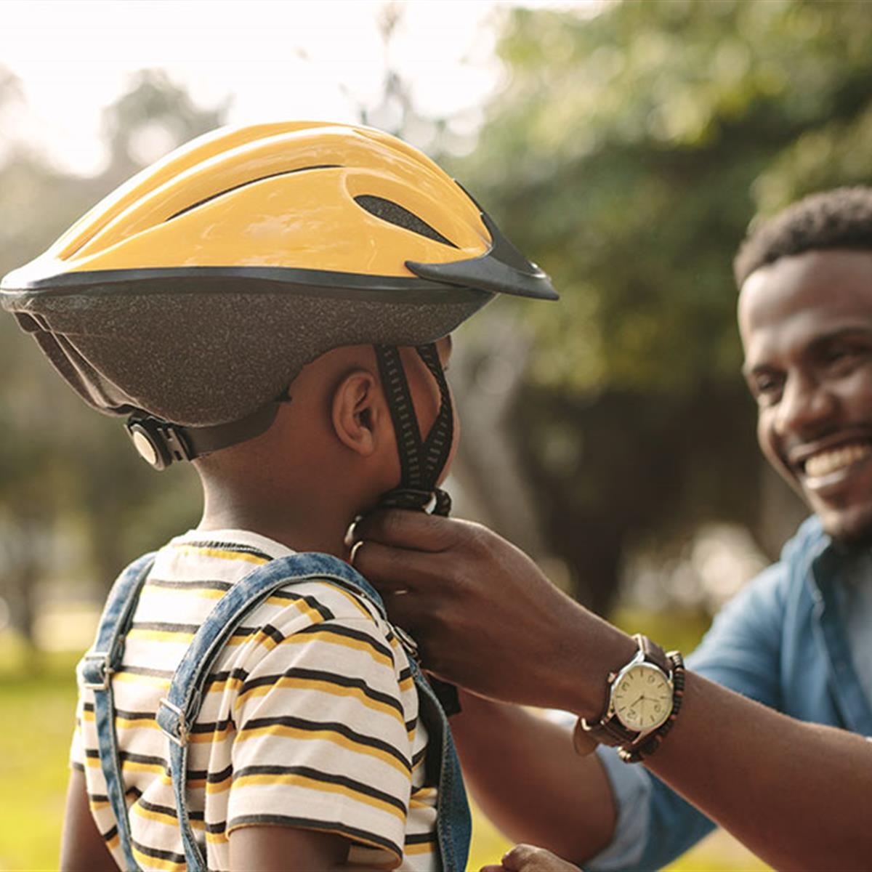
Abstract
Motorcycle accidents have been rapidly growing through the years in many countries. In India more than 37 million people use two wheelers. Therefore, it is necessary to develop a system for automatic detection of helmet wearing for road safety. Therefore, a custom object detection model is created using a Machine learning based algorithm which can detect motorcycle riders with helmet. By this system it detects the rider and if the rider with helmet, then it opens the gate and allows the biker for fuel filling. By this system we can avoid the motorcycle accidents and if we keep helmet as a mandatory for rider while filling fuel at petroleum bunks every biker will maintain and wearied with helmet using this caution, we can save the lives and they start following the traffic rules and road safety rules. This Application can be implemented in real-time using a Webcam or a CCTV as input.
CMRCET-CSE

Slide 4
Literature Review
More than 3 to 4 slides
CMRCET-CSE

Slide 5
Existing Works
The Existing system monitors the traffic violations primarily through CCTV recordings, where the traffic police have to look into the frame where the traffic violation is happening, zoom into the license plate in case rider is not wearing helmet. But this requires lot of manpower and time as the traffic violations frequently and the number of people using motorcycles is increasing day-by-day.
Hence efficient and feasible techniques have to be created to overcome these problems. Manual surveillance of traffic using a person on roads is an existing methodology.
CMRCET-CSE

Slide 6
Proposed Method Description
Implementing the helmet detection at fuel bunks using the webcam or cctv using python iot models here we are detecting the helmet of the rider who are at petroleum pump here it detects and then allows the rider to fill fuel
So, here firstly it detects helmet if helmet detected successfully then a gate will rised and allows the rider to fill fuel.
Here we using technologies Tensorflow, CNN(Convolutional Neural Network), openCv using Python.
CMRCET-CSE

Slide 7
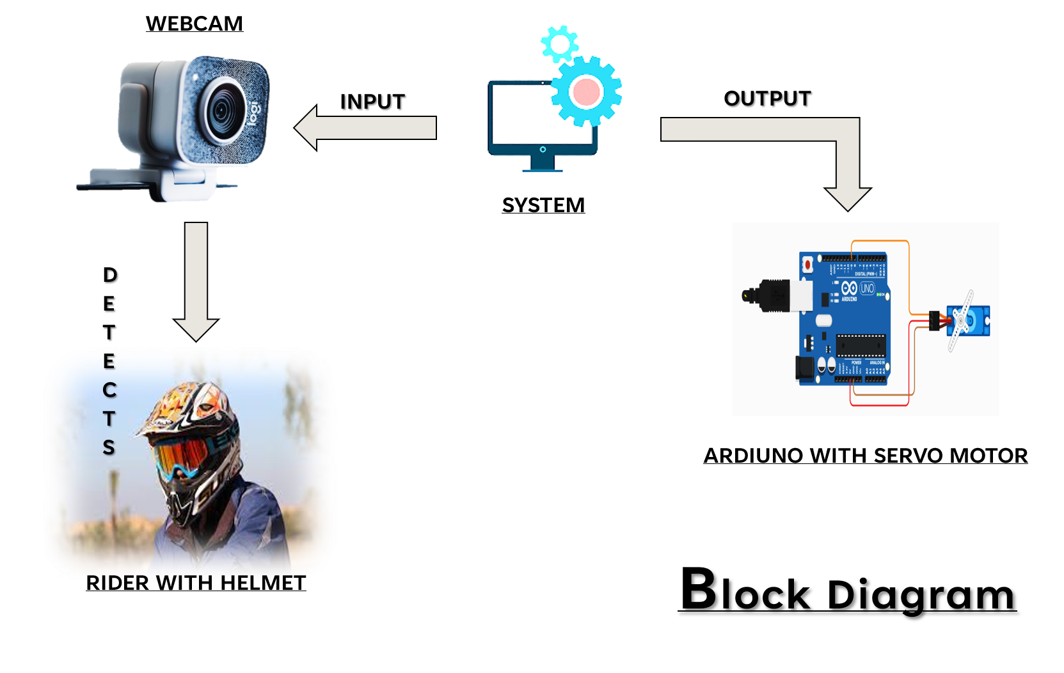
Proposed System
CMRCET-CSE

Slide 8


Proposed System
Proposed Algorithms:
Tensor Flow
CNN(Convolutional Neural Network)
OpenCV
CMRCET-CSE

Slide 9
Implementation
Status of the implementation
CMRCET-CSE

Slide 10
Plan of Execution
Give Gantt Chart including paper publication
Github link of the project repo
CMRCET-CSE

